Slide 1
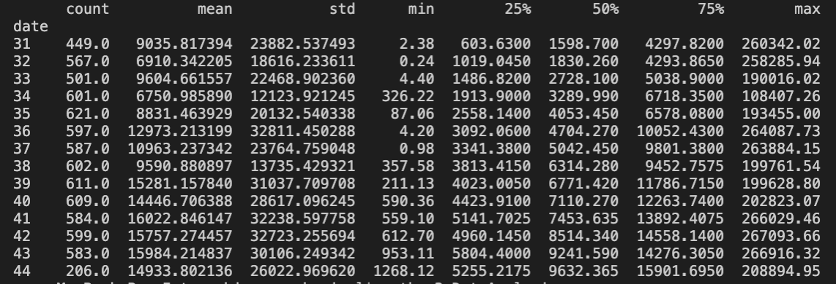
Exploratory Data Analysis
Dataset need to be cleaned to ensure that data is correct, consistent and useable
Using Python to clean dataset, data contains 7717 rows and 21 columns
The table below show the statistics of sale balancing of while analysis by monthly
Date | Count | Mean | Std. | min | 25% | 50% | 75% | max
August | 2535 | 8078.7 | 19429.61 | 0.24 | 1429.78 | 2638.42 | 5816.4 | 260342.02
October | 2581 | 15493.6 | 30573.37 | 559.1 | 4963.14 | 8224.32 | 14114.6 | 267093.66
September | 2601 | 11972.42 | 26144.57 | 0.98 | 3423.31 | 5390.5 | 9912.58 | 264087.73
Total sale balancing
The table below show the statistics of sale balancing of while analysis by weekly
Month | Balance
August | 20479509.77
October | 39989154.23
September | 31140279.67

Slide 2
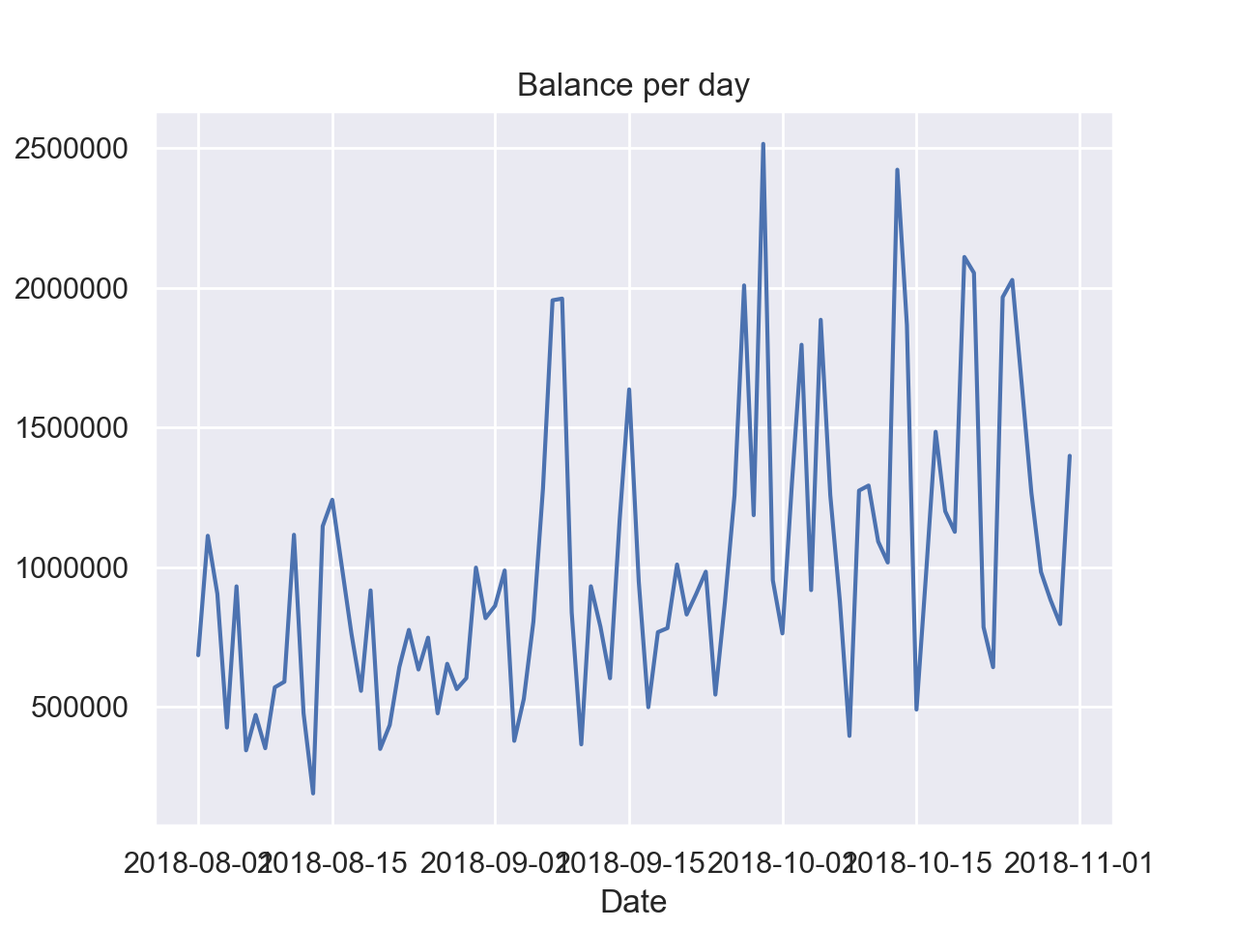
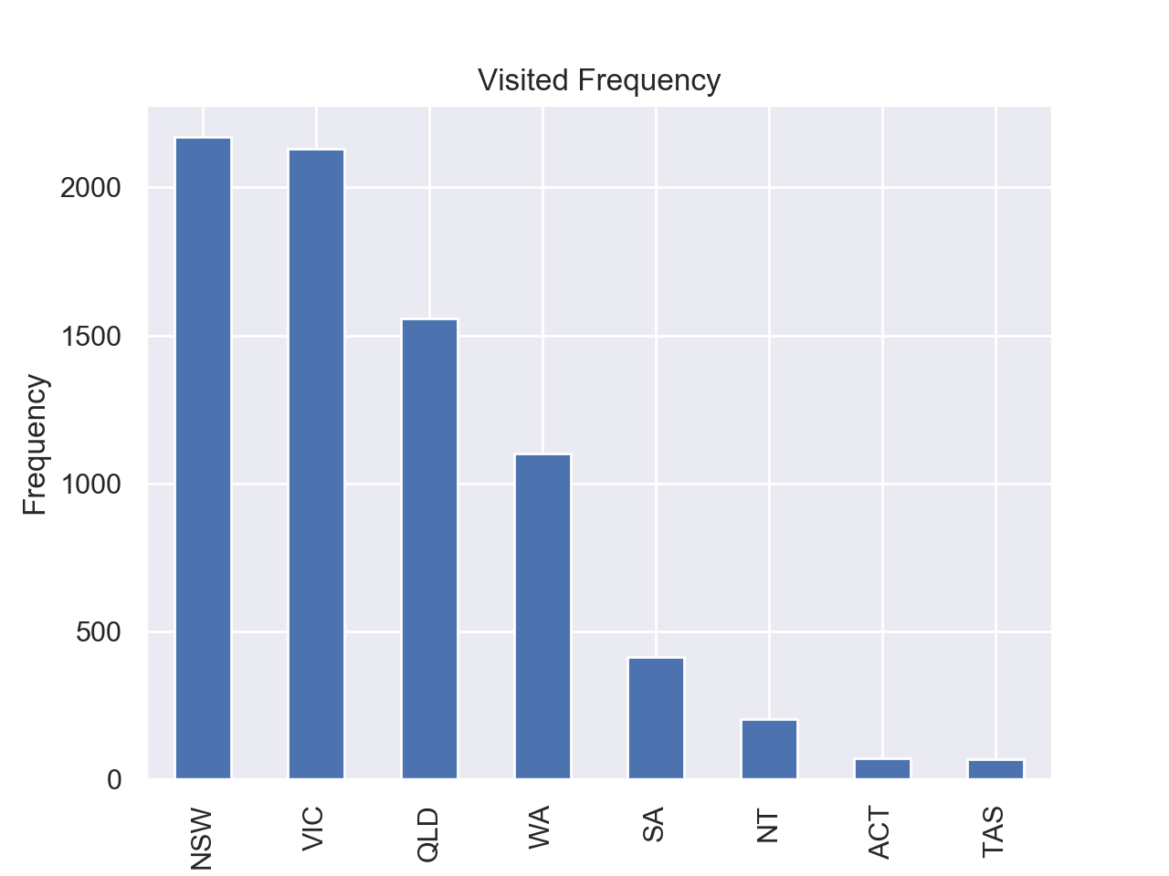
Exploratory Data Analysis
Visualizing data over the period for analysis and prediction trend of balance in the future.
Visualizing data to find frequency of visiting in each state.

